Slide 1
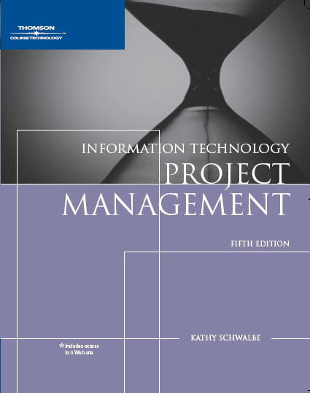
Chapter 3: The Project Management Process Groups: A Case Study

Slide 2
Learning Objectives
Describe the five project management (PM) process groups, the typical level of activity for each, and the interactions among them
Understand how the PM process groups relate to the PM knowledge areas
Discuss how organizations develop information technology PM methodologies to meet their needs

Slide 3
Learning Objectives (continued)
Review a case study of an organization applying the PM process groups to manage an information technology project, and understand the contribution that effective project initiation, project planning, project execution, project monitoring and controlling, and project closing make to project success

Slide 4
Project Management Process Groups
A process is a series of actions directed toward a particular result
Project management can be viewed as a number of interlinked processes
The project management process groups include:
Initiating processes
Planning processes
Executing processes
Monitoring and controlling processes
Closing processes

Slide 5
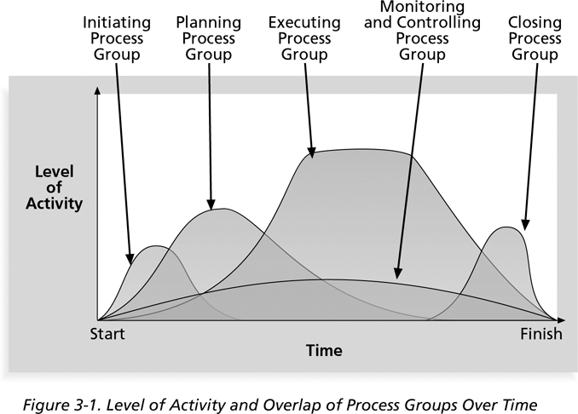
Level of Activity and Overlap of Process Groups Over Time
5

Slide 6
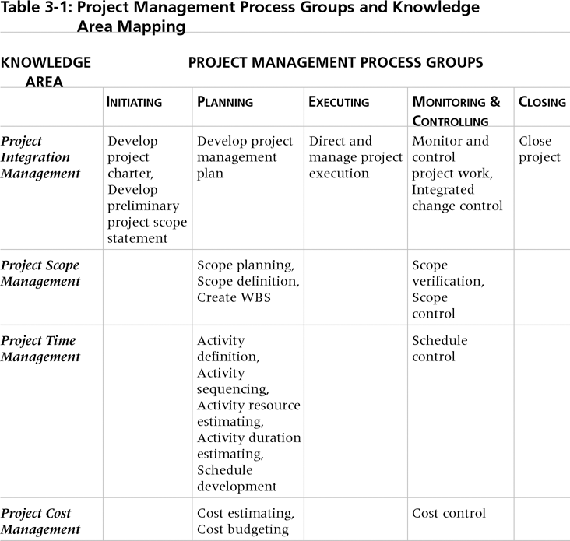
Relationships Among Process Groups and Knowledge Areas
6

Slide 7
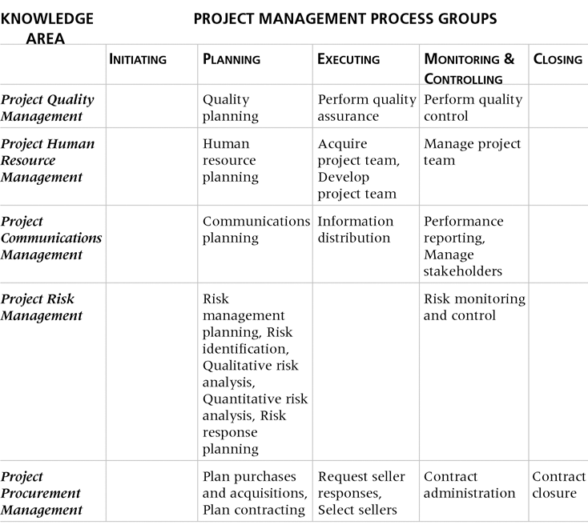
Relationships Among Process Groups and Knowledge Areas (continued)
PMBOK® Guide Third Edition, 2004, p. 69
7

Slide 8
Project Initiation
Initiating a project includes recognizing and starting a new project or project phase
Some organizations use a pre-initiation phase, while others include items like developing a business case as part of initiation
The main goal is to formally select and start off projects
Key outputs include:
Assigning the project manager
Identifying key stakeholders
Completing a business case
Completing a project charter and getting signatures on it

Slide 9
Pre-Initiation Tasks
Determine the scope, time, and cost constraints for the project
Identify the project sponsor
Select the project manager
Develop a business case for a project
Meet with the project manager to review the process and expectations for managing the project
Determine if the project should be divided into two or more smaller projects

Slide 10
Business case
Introduction/Background
Business Objective
Current Situation and Problem/Opportunity Statement
Critical Assumptions and Constraints
Analysis of Options and Recommendation
Preliminary Project Requirements
Budget Estimate and Financial Analysis
Schedule Estimate
Potential Risks

Slide 11
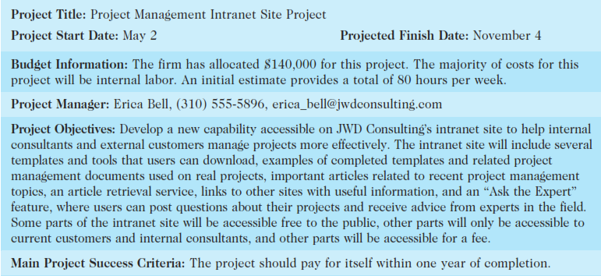
Project Charter

Slide 12
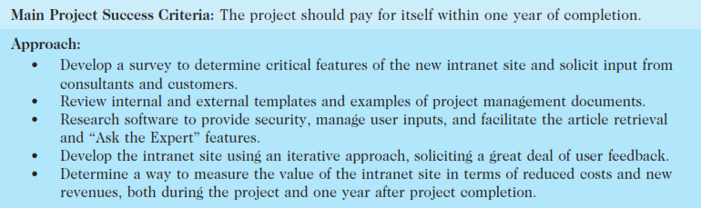

Slide 13
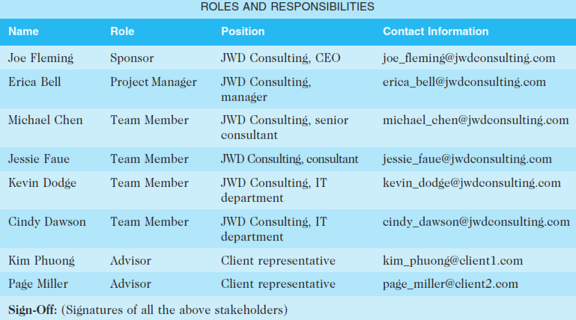

Slide 14


Slide 15
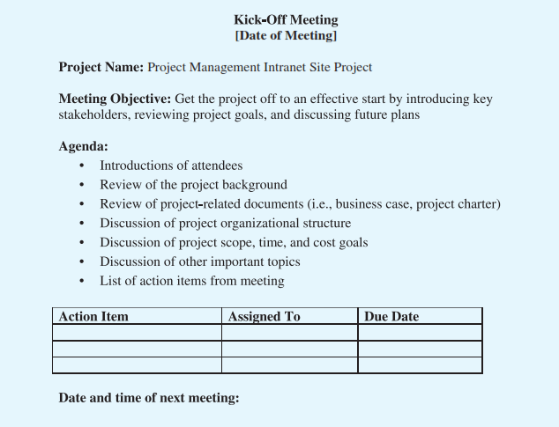

Slide 16
Project Planning
The main purpose of project planning is to guide execution
Every knowledge area includes planning information
Key outputs :
A team contract
A project scope statement
A work breakdown structure (WBS)
A project schedule, in the form of a Gantt chart with all dependencies and resources entered
A list of prioritized risks (part of a risk register)

Slide 17
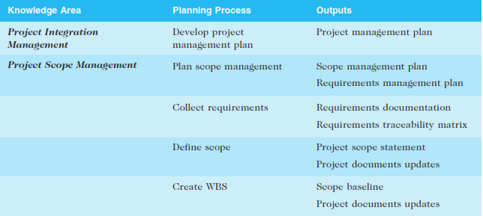
Planning processes and outputs

Slide 18
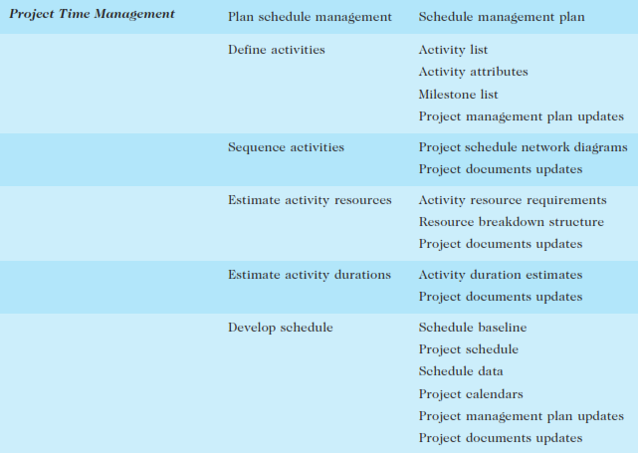

Slide 19
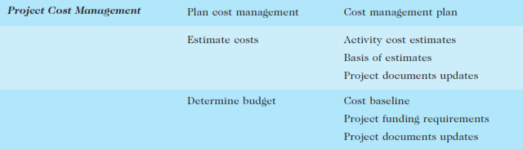

Slide 20
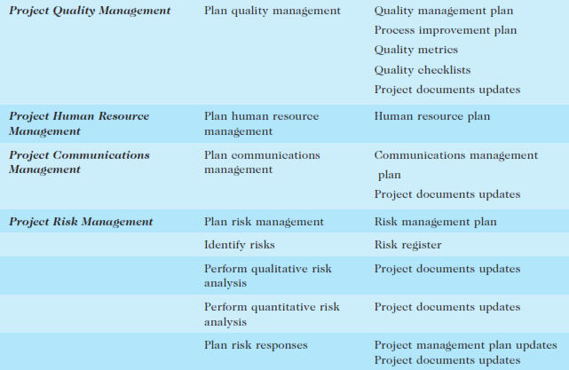

Slide 21
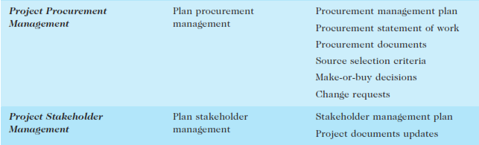

Slide 22
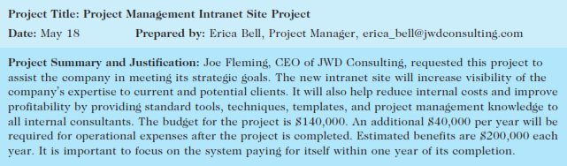
Scope statement (draft version)

Slide 23
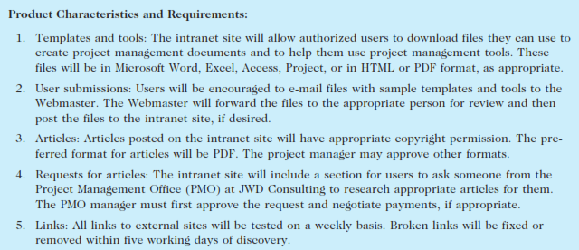

Slide 24
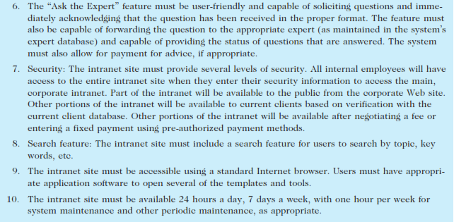

Slide 25
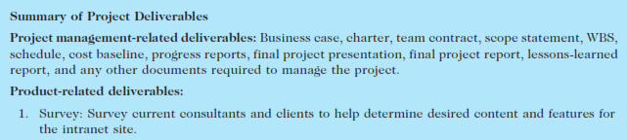
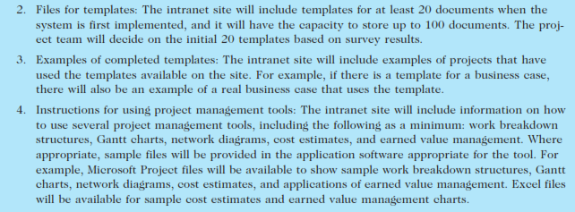

Slide 26
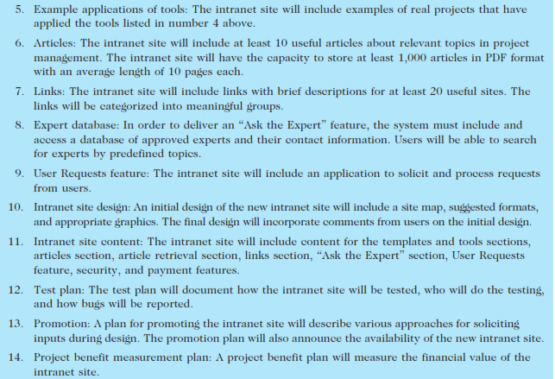

Slide 27
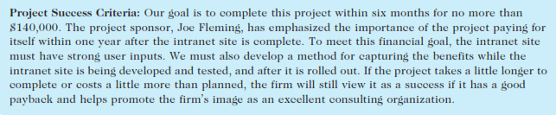

Slide 28
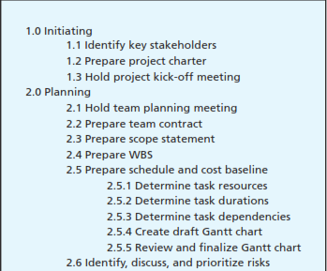
Work Breakdown Structure

Slide 29
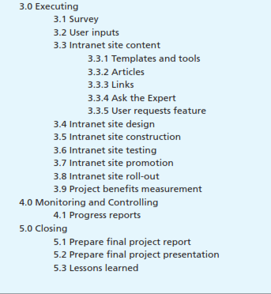

Slide 30
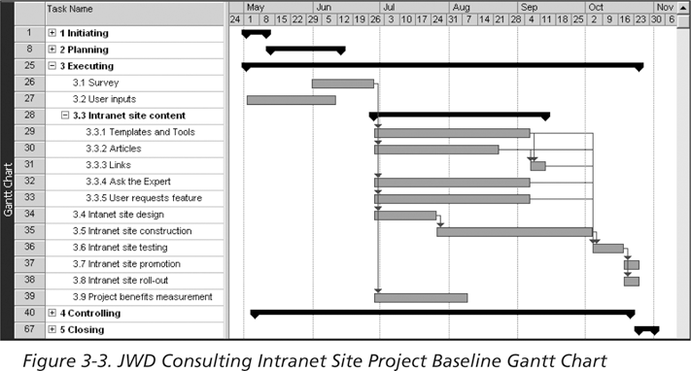
JWD Consulting Intranet Site Project Baseline Gantt Chart
30

Slide 31
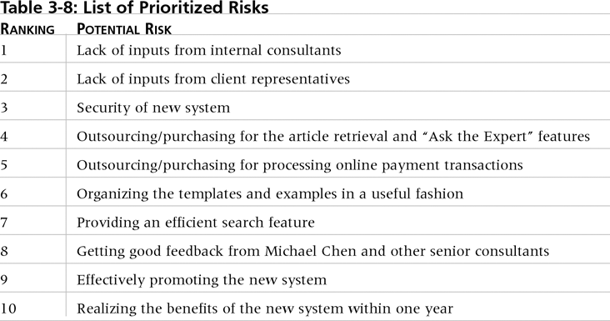
List of Prioritized Risks

Slide 32
Project Executing
Usually takes the most time and resources to perform project execution
Project managers must use their leadership skills to handle the many challenges that occur during project execution
Table 3-9 on pp. 91 lists the executing processes and outputs; many project sponsors and customers focus on deliverables related to providing the products, services, or results desired from the project
A milestone report (example on pp. 92) can help focus on completing major milestones

Slide 33
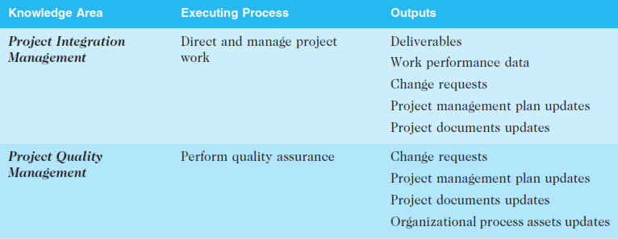
Executing processes and outputs

Slide 34
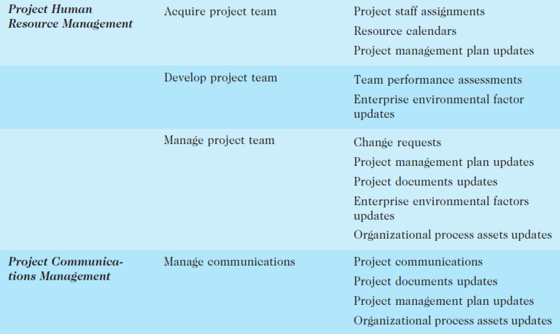

Slide 35
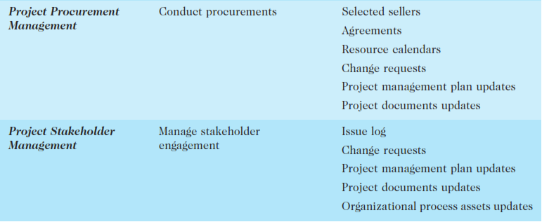

Slide 36
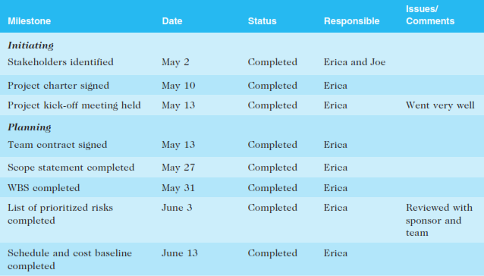
Part of Milestone Report

Slide 37
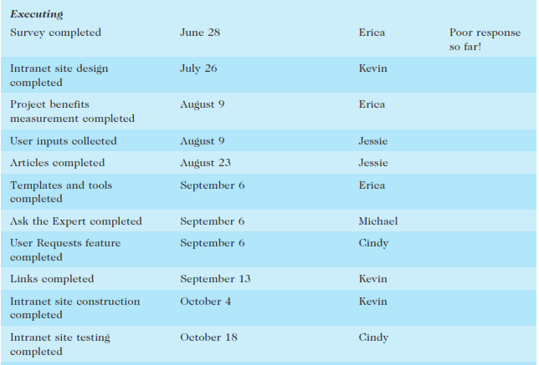

Slide 38
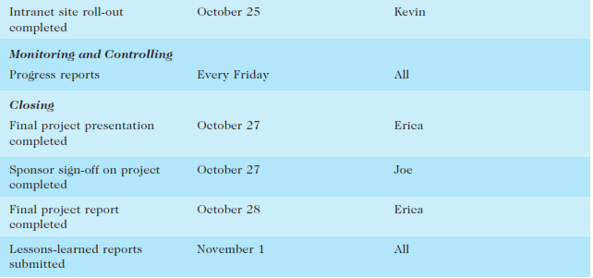

Slide 39
Project Monitoring and Controlling
Involves measuring progress toward project objectives, monitoring deviation from the plan, and taking correction actions
Affects all other process groups and occurs during all phases of the project life cycle
Outputs include performance reports, requested changes, and updates to various plans

Slide 40
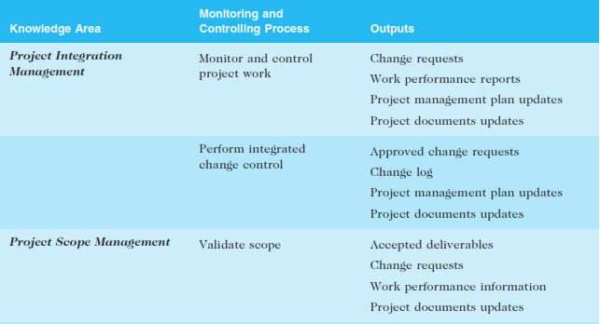
Monitoring and controlling processes and outputs

Slide 41
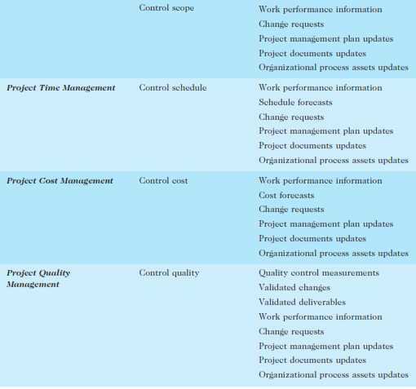

Slide 42
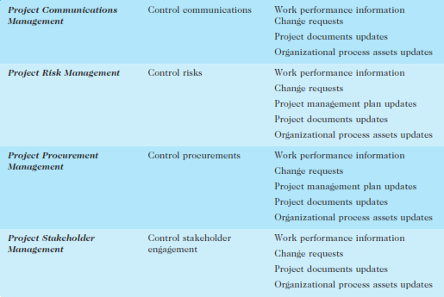

Slide 43
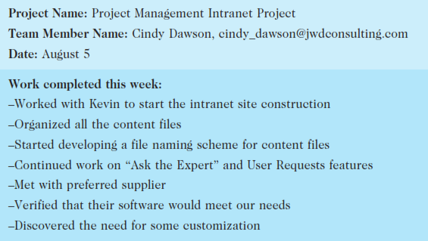
Sample weekly progress report

Slide 44
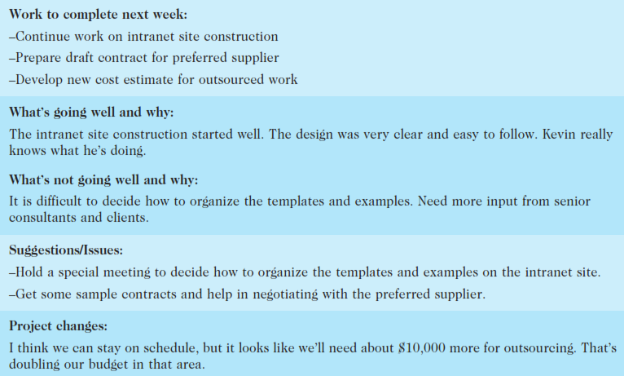

Slide 45
Project Closing
Involves gaining stakeholder and customer acceptance of the final products and services
Even if projects are not completed, they should be closed out to learn from the past
Outputs include project archives and lessons learned, part of organizational process assets
Most projects also include a final report and presentation to the sponsor/senior management

Slide 46
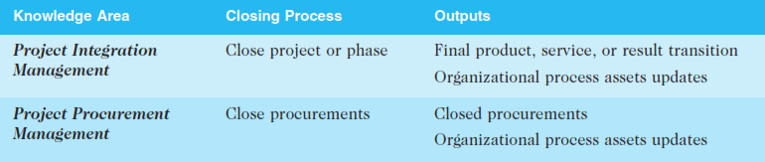
Closing processes and output

Slide 47
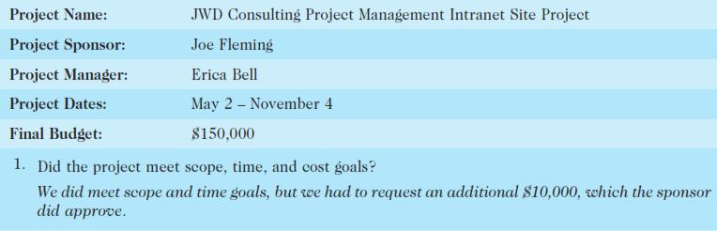
Lessons-learned report (abbreviated)

Slide 48
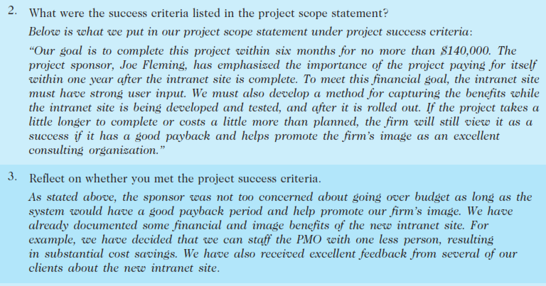

Slide 49
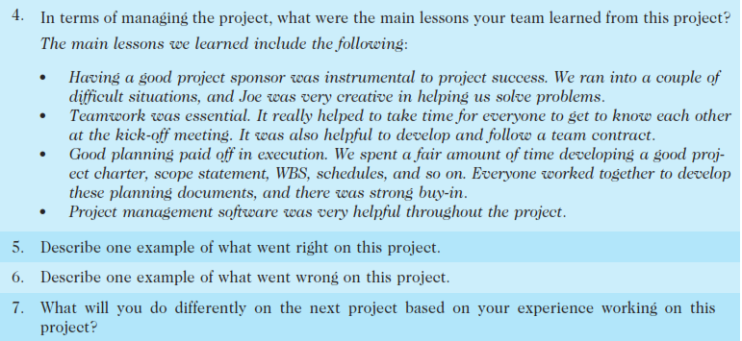

Slide 50
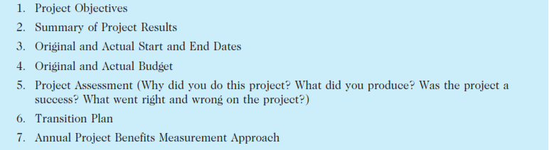
Final project report table of contents

Slide 51
